Slide 1


SAVEETHA SCHOOL OF ENGINEERING
SAVEETHA INSTITUTE OF MEDICAL AND TECHNICAL SCIENCES
COURSE CODE:
CSA1590 -CLOUD COMPUTING FOR BIG DATA ANLYTICS FOR VIRTUAL CLUSTERS
TOPIC:
Project on Abnormal Trading System
SUPERVISED BY:
Dr. Gnana Soundari
By,
NAME :N. Venkata Vamsi Krishna
REG.NO: 192210416

Slide 2

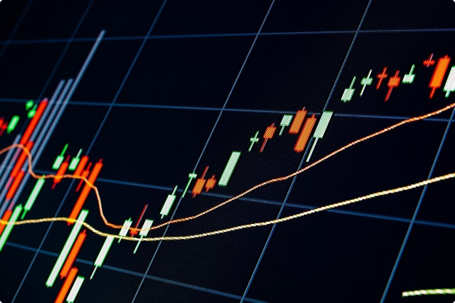
Introduction to Abnormal Trading System
The abnormal trading system is a sophisticated platform that leverages advanced algorithms and real-time data analysis to identify and capitalize on unusual market movements, enabling traders to stay ahead of the curve and maximize their returns.
An abnormal trading system refers to a set of trading strategies or patterns that deviate significantly from typical or expected market behaviors. These systems often exploit inefficiencies, anomalies, or irregularities in financial markets, aiming to generate profits that aren't achievable through conventional trading methods.
vk

Slide 3
Problem Statement
Volatility Challenge
Information Overload
Competitive Edge
Identify and respond to unpredictable market fluctuations that can significantly impact trading strategies and profitability.
Efficiently process vast amounts of financial data to detect meaningful patterns and anomalies that traditional systems may overlook.
Provide traders with a decisive advantage by detecting and acting on market opportunities faster than the competition.

Slide 4


Requirements Gathering
1
Comprehensive Data Integration
Aggregate and analyze real-time data from multiple sources, including exchanges, news feeds, and social media.
2
Predictive Analytics
Develop algorithms to identify and forecast unusual trading patterns and market anomalies.
3
User-Friendly Interface
Provide a clean, intuitive dashboard for traders to monitor the market and execute trades.
4
Robust Security
Implement stringent cybersecurity measures to protect sensitive financial information and trading activities.

Slide 5

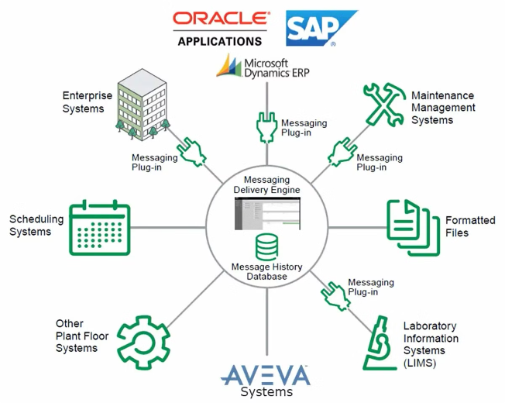



Integration with Existing Systems
Data Aggregation
Seamlessly integrate with existing market data feeds, trading platforms, and risk management systems.
Process Automation
Develop APIs and interfaces to streamline data flow and trading execution across various systems.
Scalability
Ensure the system can handle increased transaction volumes and user growth without compromising performance.

Slide 6
Develop Frontend
Intuitive Navigation
Customizable Dashboards
Advanced Visualization
Design a user-friendly interface with clear, logical workflows for seamless trading and analysis.
Allow users to personalize their trading views and access key metrics and insights with a few clicks.
Incorporate interactive charts, graphs, and data visualizations to enhance market trend analysis and decision-making.

Slide 7






Develop Backend
Data Processing
Robust data management and storage capabilities to handle large volumes of financial data.
Predictive Modeling
Leverage machine learning algorithms to identify trading patterns and forecast market movements.
Cybersecurity
Implement advanced security measures to protect against cyber threats and data breaches.
Scalability
Ensure the system can seamlessly handle increased user traffic and trading volumes.

Slide 8

Implementation and Integration with Cloud Services
Cloud-Native Architecture
Automated Deployment
Leverage the scalability, flexibility, and cost-effectiveness of cloud-based infrastructure and services.
Streamline the implementation and update process through containerization and CI/CD pipelines.
Disaster Recovery
Monitoring and Alerting
Ensure business continuity and data protection through robust backup and disaster recovery strategies.
Utilize cloud-based monitoring tools to proactively identify and address system issues.

Slide 9

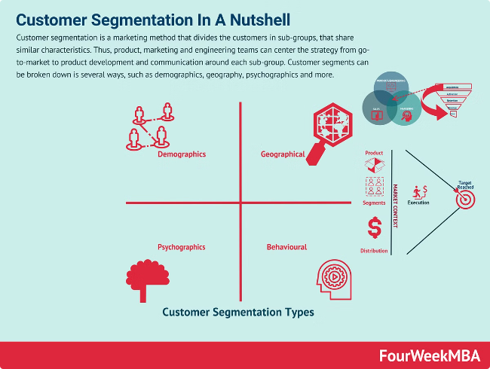
Personalization and Targeting
1
User Profiling
Analyze user behavior, preferences, and trading patterns to create personalized profiles.
2
Targeted Recommendations
Provide tailored investment insights, market analysis, and trading opportunities based on individual user profiles.
3
Adaptive Notifications
Deliver timely alerts and updates based on user preferences and market conditions.

Slide 10

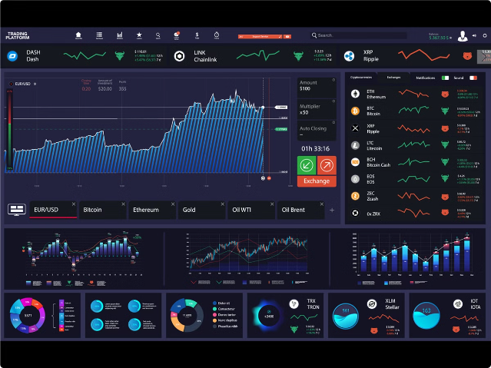
Monitoring and Analytics
Key Metrics
Performance Indicators
Anomaly Detection
Trade Volume
Profit and Loss
Unusual Trading Patterns
Order Execution Times
Risk-Adjusted Returns
Market Manipulations
User Engagement
Portfolio Diversification
Insider Trading Activities

Slide 11


Conclusion
The Abnormal Trading System represents a transformative approach to financial markets, empowering traders with advanced analytics, personalized insights, and the ability to capitalize on unique market opportunities. By seamlessly integrating with existing systems and leveraging cloud-based infrastructure, this platform sets a new standard for intelligent, data-driven trading success.

Slide 12


